Slide 1
Data Analytics
Business Analytics Overview

Slide 2
Business Analytics
(Business) Analytics is the use of:
data,
information technology,
statistical analysis,
quantitative methods, and
mathematical or computer-based models
to help managers gain improved insight about their business operations and make better, fact-based decisions.

Slide 3
Examples of Applications
Pricing
setting prices for consumer and industrial goods, government contracts, and maintenance contracts
Customer segmentation
identifying and targeting key customer groups in retail, insurance, and credit card industries
Merchandising
determining brands to buy, quantities, and allocations
Location
finding the best location for bank branches and A T M s, or where to service industrial equipment

Slide 4
Examples of Applications (continued)
Supply Chain Design
determining the best sourcing and transportation options and finding the best delivery routes
Staffing
ensuring appropriate staffing levels and capabilities, and hiring the right people
Health care
scheduling operating rooms to improve utilization, improving patient flow and waiting times, purchasing supplies, and predicting health risk factors

Slide 5
Impacts of Analytics
Benefits
…reduced costs, better risk management, faster decisions, better productivity and enhanced bottom-line performance such as profitability and customer satisfaction.
Challenges
…lack of understanding of how to use analytics, competing business priorities, insufficient analytical skills, difficulty in getting good data and sharing information, and not understanding the benefits versus perceived costs of analytics studies.

Slide 6
Evolution of Business Analytics
Analytic Foundations
Business Intelligence (BI)
Information Systems (IS)
Statistics
Operations Research/Management Science (OR/MS)

Slide 7
Evolution of Business Analytics
Modern Business Analytic
Data mining
Simulation and risk analysis
Decision Support Systems (DSS)
Visualization

Slide 8
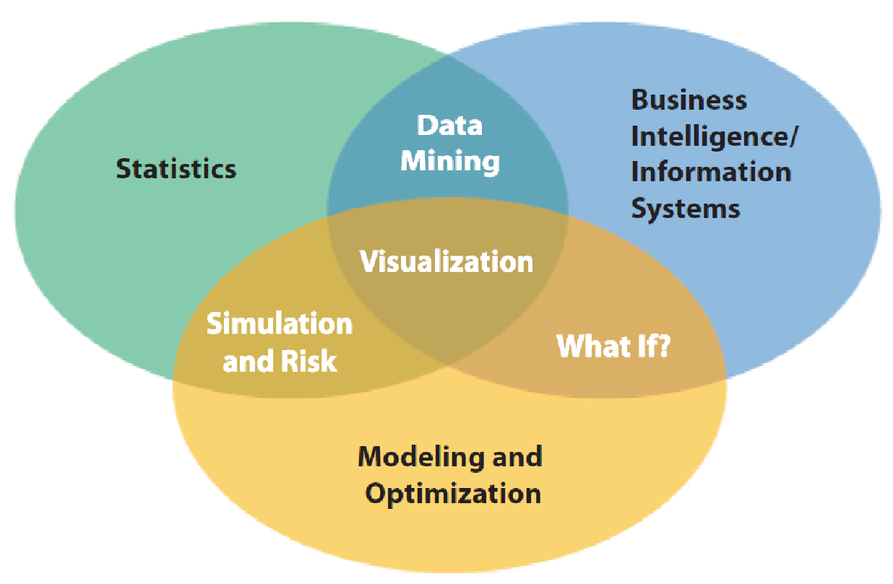
A Visual Perspective of Business Analytics

Slide 9
Software Support and Spreadsheet Technology
Commercial software
IBM Cognos Express
SAS Analytics
Tableau
Spreadsheets
Widely used
Effective for manipulating data and developing and solving models
Support powerful commercial add-ons
Facilitate communication of results

Slide 10
Software Used in This Book
Primary Spreadsheet Software
Excel 2016 for Windows
Excel 2016 for Mac
Optional Software
StatCrunch (Technology Help sections)
Analytic Solver (online supplements)

Slide 11
Descriptive, Predictive, and Prescriptive Analytics
Descriptive analytics: the use of data to understand past and current business performance and make informed decisions
Predictive analytics: predict the future by examining historical data, detecting patterns or relationships in these data, and then extrapolating these relationships forward in time.
Prescriptive analytics: identify the best alternatives to minimize or maximize some objective

Slide 12
Example 1.1: Retail Markdown Decisions
Most department stores clear seasonal inventory by reducing prices.
Key question: When to reduce the price and by how much to maximize revenue?
Potential applications of analytics in retail:
Descriptive analytics: examine historical data for similar
products (prices, units sold, advertising …)
Predictive analytics: predict sales based on price
Prescriptive analytics: find the best sets of pricing and advertising to maximize sales revenue

Slide 13
Data for Business Analytics
Data: numbers or textual data that are collected through some type of measurement process
Information: result of analyzing data; that is, extracting meaning from data to support evaluation and decision making

Slide 14
Examples of Data Sources and Uses
Annual reports
Accounting audits
Financial profitability analysis
Economic trends
Marketing research
Operations management performance
Human resource measurements
Web behavior
page views, visitor’s country, time of view, length of time, origin and destination paths, products they searched for and viewed, products purchased, what reviews they read, and many others

Slide 15
Big Data
Big data refers to massive amounts of business data (volume) from a wide variety of sources (variety), much of which is available in real time (velocity), and much of which is uncertain or unpredictable (veracity).
“The effective use of big data has the potential to transform economies, delivering a new wave of productivity growth and consumer surplus. Using big data will become a key basis of competition for existing companies, and will create new competitors who are able to attract employees that have the critical skills for a big data world.” - McKinsey Global Institute, 2011

Slide 16
Data Reliability and Validity
Reliability - data are accurate and consistent.
Validity - data correctly measures what it is supposed to measure.

Slide 17
Data Reliability and Validity Examples
A tire pressure gage that consistently reads several pounds of pressure below the true value is not reliable, although it is valid because it does measure tire pressure.

Slide 18
Data Reliability and Validity Examples
The number of calls to a customer service desk might be counted correctly each day (and thus is a reliable measure) but not valid if it is used to assess customer dissatisfaction, as many calls may be simple queries.

Slide 19
Data Reliability and Validity Examples
A survey question that asks a customer to rate the quality of the food in a restaurant may be neither reliable (because different customers may have conflicting perceptions) nor valid (if the intent is to measure customer satisfaction, as satisfaction generally includes other elements of service besides food).

Slide 20
Models in Business Analytics
Model - an abstraction or representation of a real system, idea, or object.
Captures the most important features
Can be a written or verbal description, a visual representation, a mathematical formula, or a spreadsheet.

Slide 21
Example 1.2: Three Forms of a Model
The sales of a new product, such as a first-generation iPad or 3D television, often follow a common pattern.
Verbal description: The rate of sales starts small as early adopters begin to evaluate a new product and then begins to grow at an increasing rate over time as positive customer feedback spreads. Eventually, the market begins to become saturated and the rate of sales begins to decrease.

Slide 22
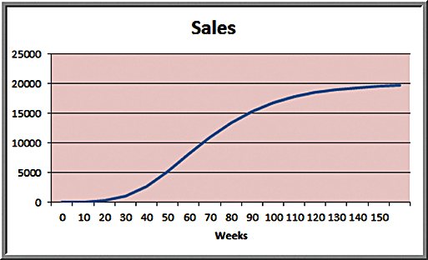
Example 1.2 Continued
Visual model: A sketch of sales as an S-shaped curve over time

Slide 23
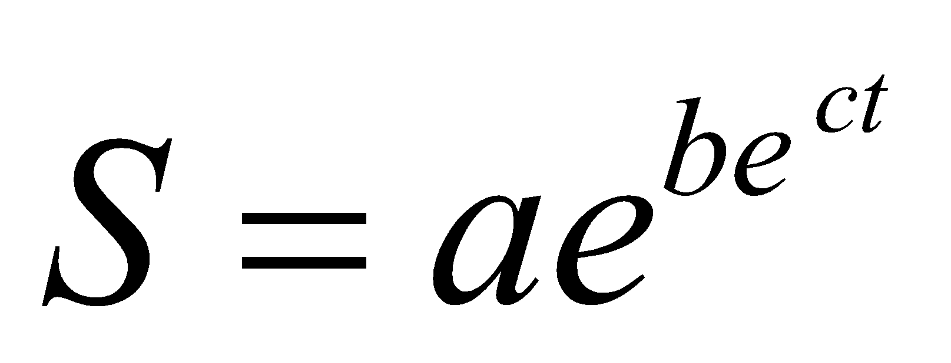
Example 1.2 Continued
Mathematical model:
where S is sales, t is time, e is the base of natural logarithms, and a, b and c are constants

Slide 24
Decision Models
Decision Model - a logical or mathematical representation of a problem or business situation that can be used to understand, analyze, or facilitate making a decision
Inputs:
Data – assumed to be constant
Uncontrollable inputs – quantities that can change but cannot be controlled
Decision options – controllable and selected at the discretion of the decision maker

Slide 25
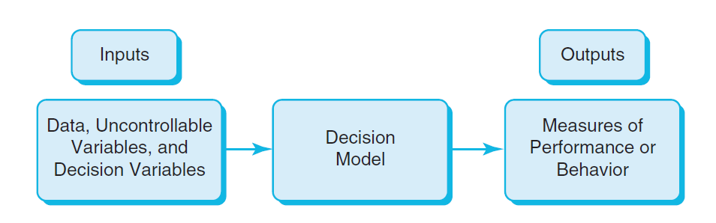
Nature of Decision Models

Slide 26
Descriptive Models
Descriptive models explain behavior and allow users to evaluate potential decisions by asking “what-if?” questions.

Slide 27
Example 1.3: Gasoline Usage Model
G = gallons of fuel consumed per month
m = miles driven per day to and from work or school
d = number of driving days per month
f = fuel economy in miles per gallon (mpg)
a = additional miles for leisure and household activities per month

Slide 28
Example 1.3 Continued
Use dimensions for logical consistency:
(m miles/day) x (d days/month) = m x d miles/month
Total miles driven per month = m x d + a
Gallons consumed per month
= (m x d + a miles/month)/(f miles/gallon)
= (m x d + a)/f gallons/month

Slide 29
Example 1.4: An Outsourcing Decision Model
Production cost: $125/unit plus fixed cost of $50,000
Outsourcing cost: $175/unit
Q = production volume
TC (manufacturing) = $50,000 + $125 x Q
TC (outsourcing) = $175 x Q
Breakeven Point: TC (manufacturing) = TC (outsourcing)
$50,000 + $125 x Q = $175 x Q
$50,000 = 50 x Q
Q = 1,000
If Q < 1,000, outsourcing is cheaper.

Slide 30
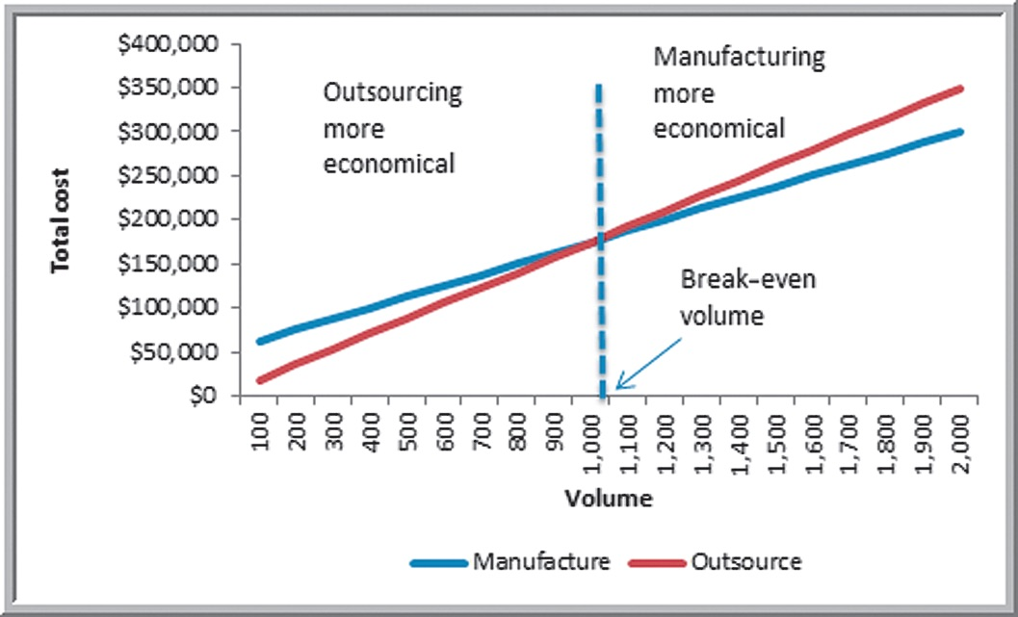
Example 1.4 Continued

Slide 31
Predictive Models
Predictive models focus on what will happen in the future.
Many predictive models are developed by analyzing historical data and assuming that the past is representative of the future.

Slide 32
Example 1.5: A Sales-Promotion Decision Model
In the grocery industry, managers typically need to know how best to use pricing, coupons, and advertising strategies to influence sales. Grocers often study the relationship of sales volume to these strategies by conducting controlled experiments to identify the relationship between them and sales volumes. That is, they implement different combinations of pricing, coupons, and advertising, observe the sales that result, and use analytics to develop a predictive model of sales as a function of these decision strategies.

Slide 33
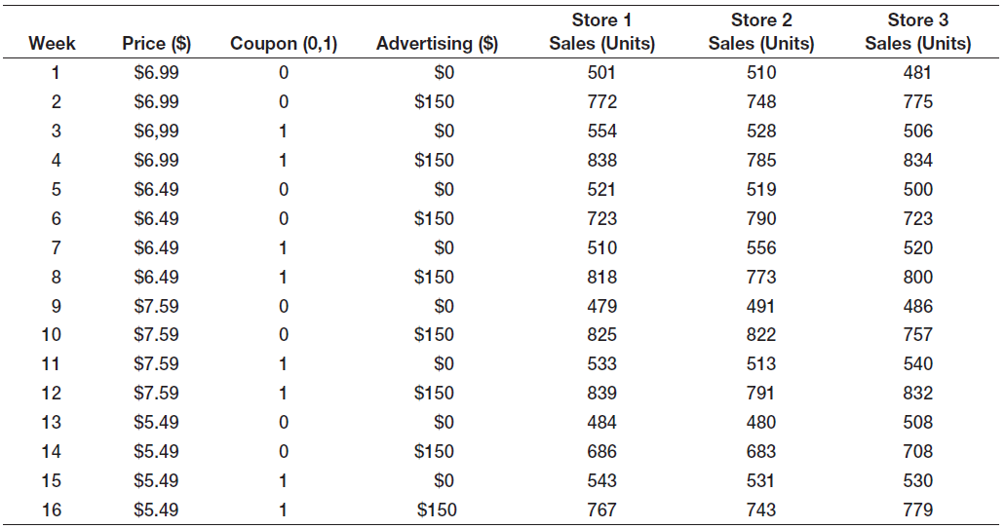
Example 1.5 Model
Model:
Total Sales = 1105.55 + 56.18 x Price + 123.88 x Coupon + 5.25 x Advertising
If the price is $6.99, no coupons are offered, and no advertising is done (the experiment corresponding to week 1), the model estimates sales as
Total Sales = 1105.55 + 56.18 x 6.99 + 123.88 x 0 + 5.25 x 0 = 1,498.25 units

Slide 34
Prescriptive Models
Prescriptive models help decision makers identify the best solution to a decision problem.
Optimization - finding values of decision variables that minimize (or maximize) something such as cost (or profit)
Objective function - the equation that minimizes (or maximizes) the quantity of interest
Optimal solution - values of the decision variables at the minimum (or maximum) point

Slide 35
Example 1.6: A Prescriptive Pricing Model
A firm wishes to determine the best pricing for one of its products in order to maximize revenue.
Analysts determined the following model:
Sales = -2.9485 x Price + 3,240.9
Total Revenue = Price x Sales
= Price x (-2.9485 x Price + 3,240.9)
= -2.9485 x Price² + 3,240.9 x Price
Identify the price that maximizes total revenue.

Slide 36
Model Assumptions
Assumptions are made to
simplify a model and make it more tractable; that is, able to be easily analyzed or solved.
better characterize historical data or past observations.
The task of the modeler is to select or build an appropriate model that best represents the behavior of the real situation.

Slide 37
Model Assumptions - Example
Economic theory tells us that demand for a product is negatively related to its price. Thus, as prices increase, demand falls, and vice versa (modeled by price elasticity — the ratio of the percentage change in demand to the percentage change in price).
A key assumption in developing a model is the type of relationship between demand and price.

Slide 38
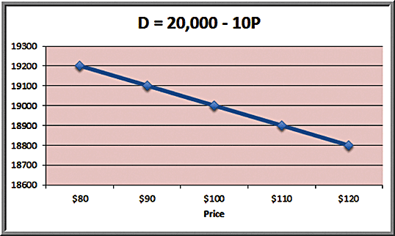
Example 1.7: A Linear Demand Prediction Model
As price increases, demand falls. A simple model is:
D = a – bP
where D is the demand, P is the unit price, a is a constant that estimates the demand when the price is zero, and b is the slope of the demand function.

Slide 39
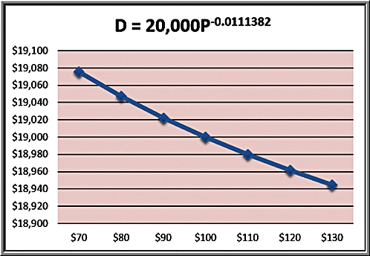
Example 1.8: A Nonlinear Demand Prediction Model
Assumes price elasticity is constant (constant ratio of % change in demand to % change in price):
D = cP^{-d}
where c is the demand when the price is 0 and d > 0 is the price elasticity.

Slide 40
Uncertainty and Risk
Uncertainty is imperfect knowledge of what will happen in the future.
Risk is associated with the consequences of what actually happens.
“To try to eliminate risk in business enterprise is futile. Risk is inherent in the commitment of present resources to future expectations. Indeed, economic progress can be defined as the ability to take greater risks. The attempt to eliminate risks, even the attempt to minimize them, can only make them irrational and unbearable. It can only result in the greatest risk of all: rigidity.”
Peter Drucker

Slide 41
Problem Solving with Analytics
Recognizing a problem
Defining the problem
Structuring the problem
Analyzing the problem
Interpreting results and making a decision
Implementing the solution

Slide 42
Recognizing a Problem
Problems exist when there is a gap between what is happening and what we think should be happening.
For example, costs are too high compared with competitors.

Slide 43
Defining the Problem
Clearly defining the problem is not a trivial task.
Complexity increases when the following occur:
large number of courses of action
the problem belongs to a group and not an individual
competing objectives
external groups are affected
problem owner and problem solver are not the same person
time limitations exist

Slide 44
Structuring the Problem
Stating goals and objectives
Characterizing the possible decisions
Identifying any constraints or restrictions

Slide 45
Analyzing the Problem
Analytics plays a major role.
Analysis involves some sort of experimentation or solution process, such as evaluating different scenarios, analyzing risks associated with various decision alternatives, finding a solution that meets certain goals, or determining an optimal solution.

Slide 46
Interpreting Results and Making a Decision
Models cannot capture every detail of the real problem.
Managers must understand the limitations of models and their underlying assumptions and often incorporate judgment into making a decision.

Slide 47
Implementing the Solution
Translate the results of the model back to the real world.
Requires providing adequate resources, motivating employees, eliminating resistance to change, modifying organizational policies, and developing trust.

